Slide 1
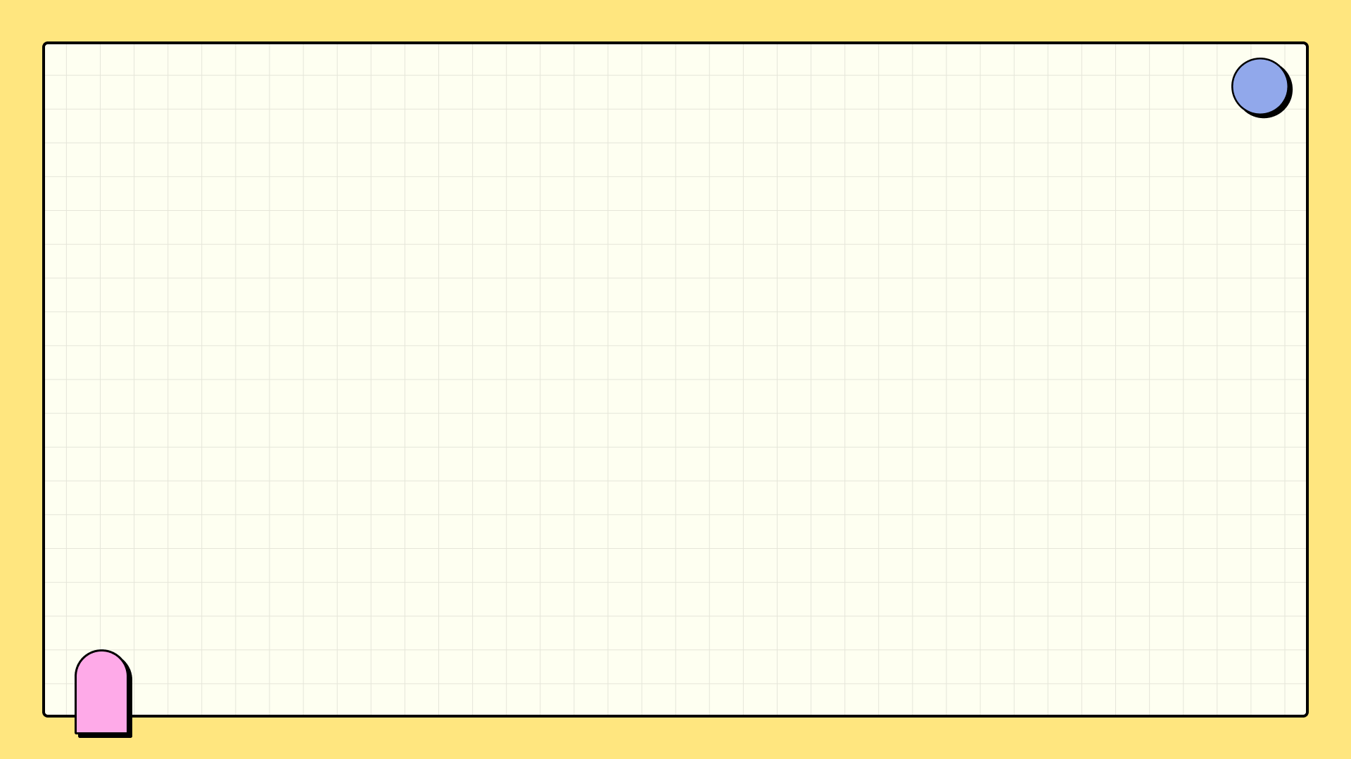

Space Savvy
Orrery Website: Visualizing Near-Earth Objects
Team Members
Alekh Sachan
Kunal Kushwaha
Aditya Raj Pandey
Tanishka Mishra

Slide 2
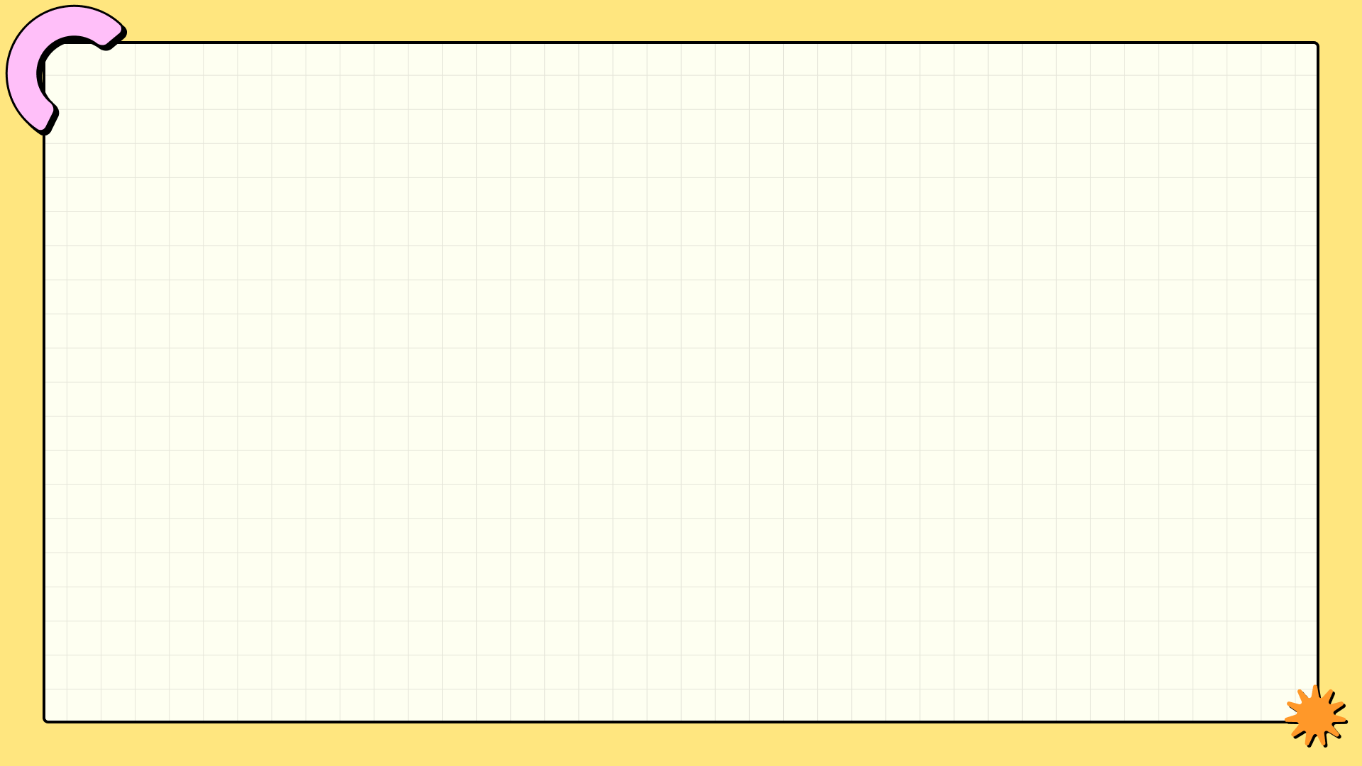

Introduction to NEOs
Near-Earth Objects (NEOs), including asteroids and comets, are vital for studies regarding Earth's safety and space exploration.
Tracking these celestial bodies helps prevent potential collisions with Earth, which can have catastrophic consequences.
However, many remain unaware of NEOs and their possible threats due to limited data accessibility.
Our goal is to bridge this gap and enhance public understanding of NEOs.
Photo by Pexels

Slide 3

Objective of the Project
Our primary goal is to develop an interactive web app that visualizes the orbits of NEOs in real-time.
By offering real-time data, we provide crucial insights into NEO trajectories and potential impact risk.
Moreover, we aim to educate the general public on the significance of monitoring these celestial objects.
Through engagement, we hope to inspire a wider interest in planetary defense and space science.
Photo by Pexels

Slide 4

Features of Our Website
Interactive 3D Visualization using Three.js allows users to explore NEO orbits like never before.
In-depth NEO information including size, speed, and trajectory empowers users to understand potential risks.
An alert system notifies users about threatening NEOs, ensuring timely awareness and action.
Educational resources support learning about asteroids and comets, enhancing user experience.
Photo by Pexels

Slide 5

Live Demo Experience
Experience our web app in action as we visually represent NEO orbits in stunning 3D.
Users can click on any NEO to view detailed information, including its trajectory, size, and speed.
Witness the alert system in action, providing notifications for NEOs that pose a potential threat to Earth.
Future improvements will expand functionality, making the app even more engaging and informative.
Photo by Pexels

Slide 6

Conclusion and Future Vision
Visualizing NEOs is essential for awareness and preparedness regarding space threats.
Our future enhancements will include integrating more detailed impact analysis and predictive data.
We envision a community equipped with knowledge to respond to cosmic dangers effectively.
Together, we can foster a safer future and ignite passion for space exploration and protection.
Photo by Pexels

Slide 7

Thank You!
Thank you for exploring the Orrery Web Website presentation with us today.
We appreciate your interest in Near-Earth Object awareness and monitoring.
For any questions or feedback, feel free to reach out to us after the presentation.
Let’s continue to promote safety and knowledge about our cosmic surroundings together!

